Slide 1
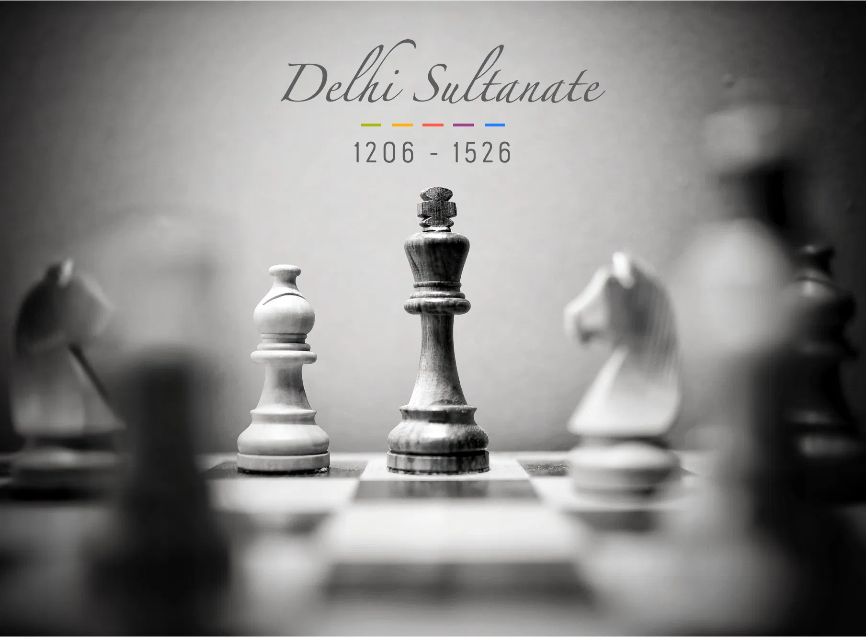

Slide 2
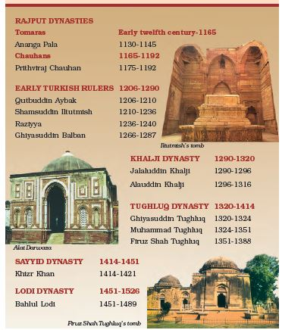
Basic Information
Five different dynasties – The Slave, Khalji, Tughlaq, Sayyids and Lodi’s are collectively referred as Delhi Sultanate.
The Rulers, termed as Sultans, were of Turkish and Afghan origin.
Not only did they extend there rule over North India (I.e. Malwa and Gujrat) but they also penetrated into the decan and South India.
The Sultanate’s rule resulted in far reaching changes in the Indian society , administration and cultural life.
Founder- Qutubddin Aibak
Real founder - Iltutmish

Slide 3
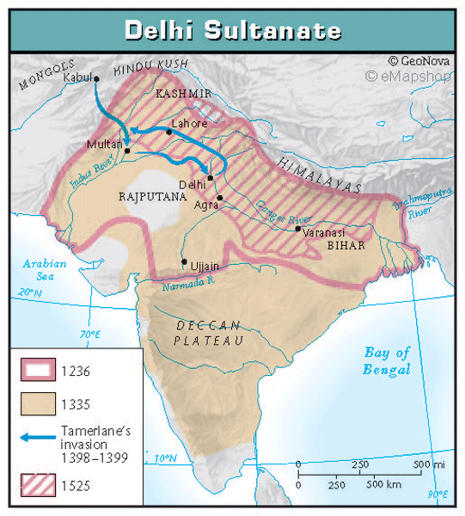
Greatest ruler – Alauddin Khilji
Last ruler – Ibrahim Lodi
First Capital – Lahore
New capital – Delhi
Religion – Islam
Language – Arabic, Turkey, Persian, Urdu
Greatest ruler – Alauddin Khilji
Last ruler – Ibrahim Lodi
First Capital – Lahore
New capital – Delhi
Religion – Islam
Language – Arabic, Turkey, Persian, Urdu

Slide 4
Slave Dynasty (1206-90 AD)
After Md Ghori’s death , all the muslim rulers who ruled over India form 1206-90, were either slaves or were descendants of the Slave Ruler. So the dynasty , is generally known as the Slave Dynasty.
The Slave dynasty mainly comprised of three small dynasties, namely:
Qutubi Dynasty
1st Ilbari Dynasty
2nd Ilbari dynasty

Slide 5
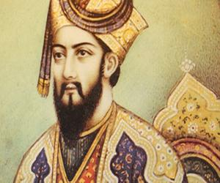
Qutub-ud-din-Aibak
A Turkish slave by origin, he was purchased by Md Ghori, who later made him his Governor. After the death of Md Ghori, Aibak declared his independence and set up his own rule at Indraprastha, near Delhi.
He started the slave dynasty ,as well as Delhi Sultanate.
He assumed the title “Sultan” and made Lahore his capital.
He was given the title of “Lakh Baksh” for his generosity (Giver of lakhs)
He patronized the great scholar “Hasan- in –Nizami” and started the construction of Qutub Minar, on the memory of famous Sufi Saint” Khwaja- i-Qutubuddin- Bakhtiyar-kaki.”
He constructed Quwat-ul-Islam mosque in Delhi (located in Qutub complex) and Adhai din ka jhopra in Ajmer.
He died playing Chaugan (Horse polo) in 1210.
Note:
Quawat-ul-Islam is the first mosque of India

Slide 6
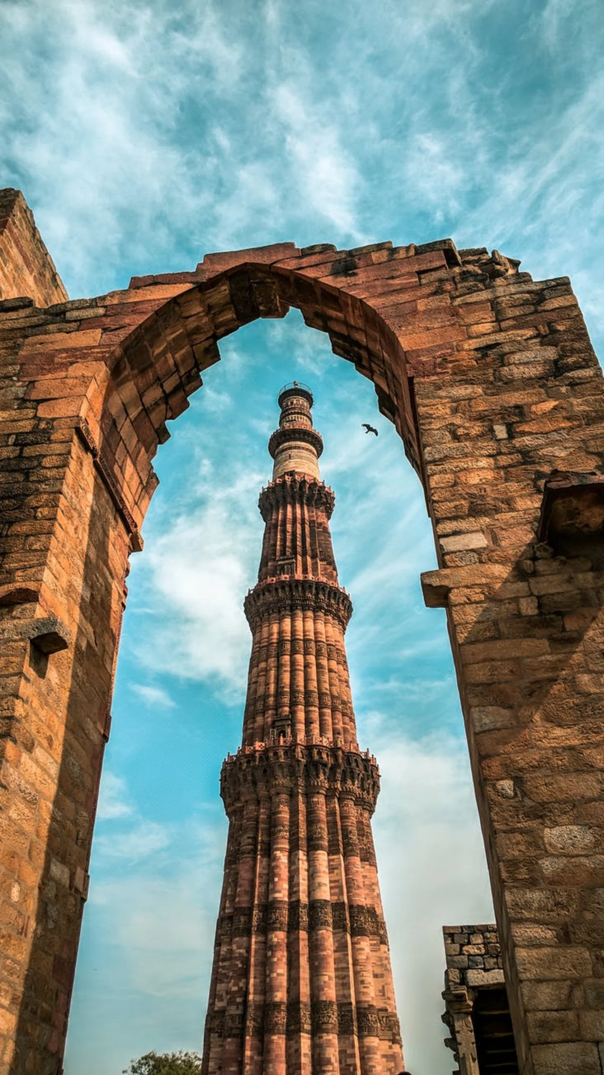
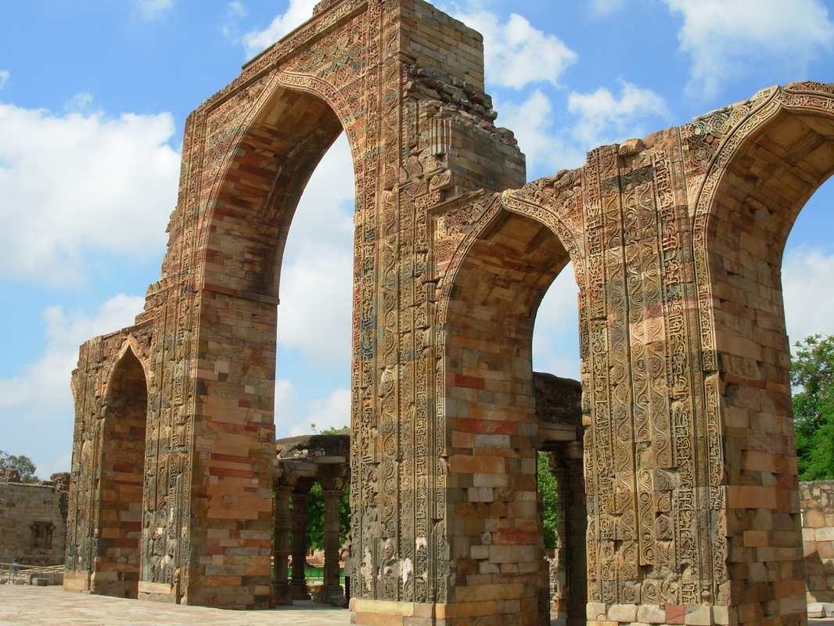

Slide 7
Aram Shah
After the death of Qutb-ud-din, his son Aram Shah succeeded him.
He was proved quite incompetent.
Some of the nobles rose to the occasion and invited Aibak’s son in law and Governor of Badaun, Iltutmish to ascend the throne.
Iltutmish deposed Aram Shah and secured the throne for himself

Slide 8
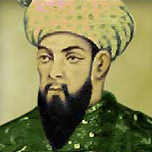
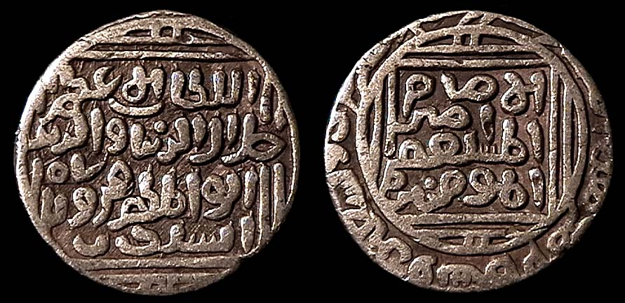
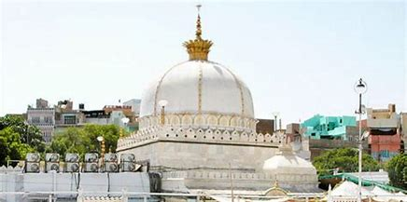
Shamsuddin Iltutmish
The real consolidator of the Turkish conquest in India and the greatest slave king was Shamsuddin Iltutmish.
His Dynasty’s name was Ilbari Dynasty.
He was slave of Aibak, later become his son-in-law.
After defeating Aram Shah, he became a Sultan in 1211.
His capital shifted from Lahore to Delhi.
Construction of Qutub Minar was completed by him.
The Ajmer Sharif mosque was built by him.
Coin – Jital (Copper) and Tanka (Silver).
He introduced Iqta System( Reforms in civil administration and army which were paid and recruited by him).

Slide 9
The famous 40 nobles or Chahalgani, which was a new class of ruling elites was started by him.
Prevented Chengiz Khan attack by refusing to give shelter to an enemy of Khan, Jalaluddin Mangabarani ( a ruler from Iran). Thus, due to his diplomatic skills, he prevented Mongol attack.
He got his authority (Sultanate of Delhi) recognized by caliph of Baghdad (Khalifa), as a member of world fraternity of Islamic States (Sultan- I – Azam).
He patronized Minhaj-ul-Siraj, the author of Tabaqat-i- Nasiri ( Dedicated to Nasiruddin Mehmud, eight Sultan of Slave Dynasty).
He is called “ Father of Tomb Building”. Built – Hauz –i- Shamsi (Near Meharuli). Sultan Garhi ( in Delhi). Destroyed Mahakal temple (Ujjain) in 1235.
Declared daughter Raziya as his successor, thus deviating from Normal Practice.

Slide 10
Ruknuddin Firuz Shah
Iltutmish had too many sons but as all of them were incompetent, so he appointed his daughter Raziya as his successor.
In spite of this, this nobles of the court who considered themselves too proud to bow their heads before a woman, put of the thorne Ruknuddin Firuz Shah, who was the eldest son of Iiltutmish. But he was an utterly worthless person.
He took pleasure in riding through the streets of Delhi on an elephant and scattering gold among the people. He left the work of the Government in the hand of his ambitious mother, Shah Tukran. She was originally a Turkish handmaid. She had her revenge against all those who has offended her in her youth.
The result of all these was that the rebellions occurred on all sides. Finally Ruknuddin and his mother were put to death and throne was given to Raziya.

Slide 11
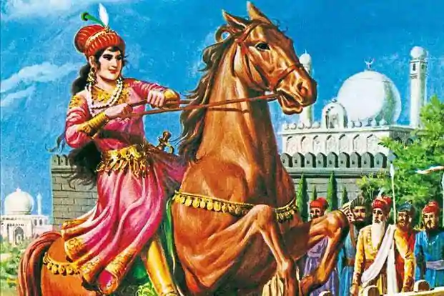
Raziya
She was the first and last muslim woman ruler of medieval India.
She disregarded the Purdah, began to attire and rode out in public on Elephant back.
She promoted Jalaluddin Yaqut, an Abyssinian (from Ethiopia) to the important office of Superintendent of the stables ( Amir- I – Akhur). It provoked the Turkish nobles. There were simultaneous revolts in the various parts of the kingdom. The Governor of Lahore was the first to create trouble but he was defeated.
There was a serious rebellion in Bhatinda. Malik Ikhiyaruddin Altunia, Governor of Bhatinda, refused to acknowledge the suzerainty of Raziya. Raziya, accompanied by Yaqut marched against Altunia. On the way , the Turkish followers of Altunia murderd Yaqut and imprisoned Raziya. She had to marry Altunia to get out of the situation.
But She was killed , along with her husband, by Bharam Shah, a son of Iltutmish, on their way back to Delhi.
Razjiya was an excellent horsewomen who led the army itself. Her only problem was that she was a lady. Minaj- Ul –Siraj considers Raziya more able than her brothers.

Slide 12
After Raziya, the battle of succession continued in which the following rulers ruled insignificantly:
Muizuddin Bahram Shah
Alauddin Masud Shah
Nasiruddin Mehmud

Slide 13
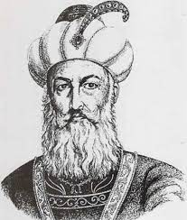
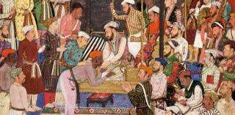
Balban
He himself was a member of Challisa. To guard himself, he got every member of Iltutmish family killed and gave a death blow to the Turkish nobility. (challisa)
He ordered the separation of military department ( Diwan -I – arz) from the finance department (diwan-i-wizarat).
He declared the sultan as the representative of God on earth. He impressed upon the people that king was the deputy of god (niyabat-i-khudai) and the shadow of god (Zil-i-ilahi).
Introduced Sijdah (the action of lying stretched out on the ground) and Paibos (kissing the sultan’s feet) practice.
He prohibited drinking, jokes, laugh and even smile among the courtiers and officers.
He started the festival of “ Nauroz” ( Persian new year)

Slide 14
After Balban’s death, his grandson Kaiqubad sat on the throne , but he was inefficient and fun loving person.

Slide 15
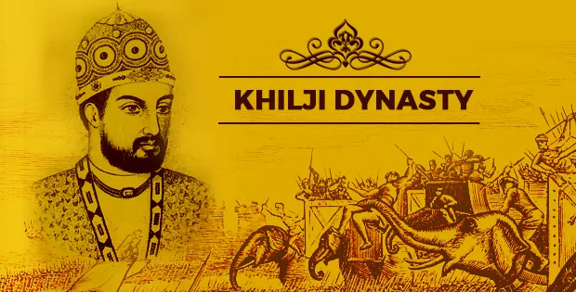
THE KHALJI DYNASTY (AD 1290-1320)
A group of Khalji nobles led by Jalaluddin Khalji, overthrew the incompetent successors of Balban in AD 1290. The Khalji rebellion was welcomed by the non-Turkish nobility. The Khaljis did not exclude the Turks from high offices, but ended the Turkish monopoly

Slide 16
Jalaluddin Khalji (AD1290-1296)
He was the first ruler of the Delhi Sultanate to clearly put forward the view that the state should be based on the willing support of the governed and that since the large majority of the people in India were Hindus, the state in India could not be a truly Islamic state.
He adopted the policy of tolerance and avoiding harsh punishment.
The most important aspect of his reign was the invasion of Devagiri in 1294, by his nephew and son-in-law Alauddin Khalji.

Slide 17
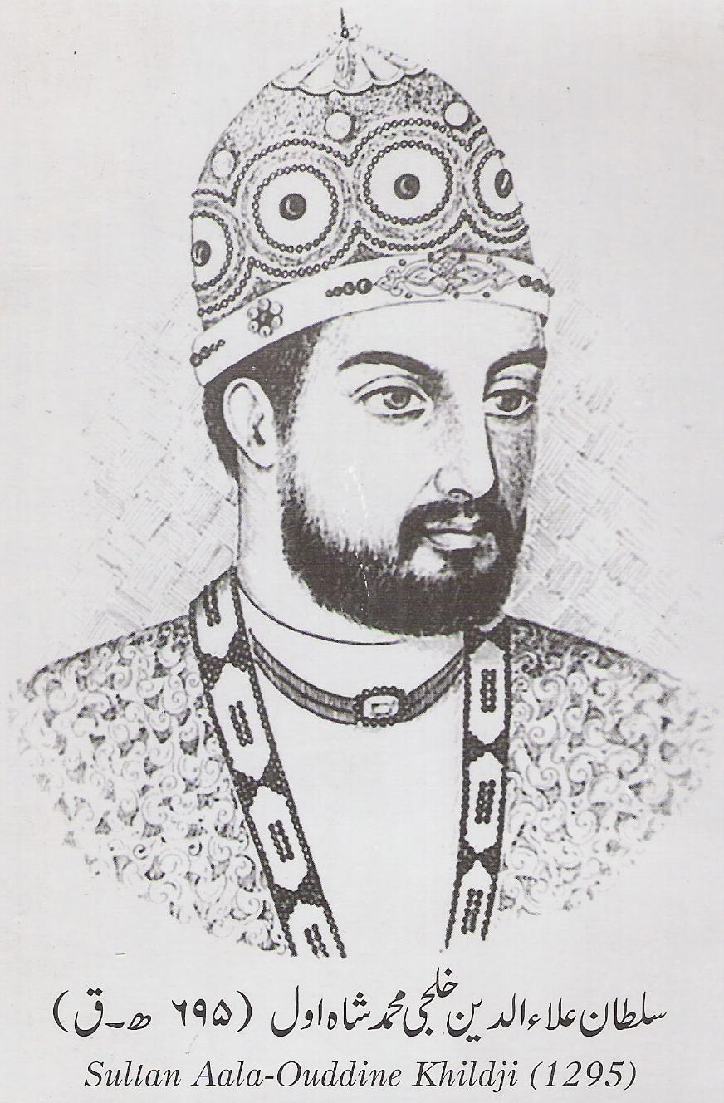
Alauddin Khalji (1296-1316)
He came to the throne by murdering his uncle and father-in-law Jalaluddin Khalji.
He proclaimed himself as Sultan winning over the nobles and soldiers to his side by the lavish use of gold.
He massacred the rebellious nobles, relatives, family members and the Mongols who had settled in Delhi.
Alauddin gave harsh punishment even to the wives and children of all nobles.
Alauddin framed a series of regulations to prevent the nobles from conspiring against him. They were forbidden to hold banquets of festivals or to form marriage alliances without the permission of the Sultan.
To discourage the festival parties, he banned the use of wines and intoxicants. He also instituted a spy service to keep himself informed of all that the nobles said and did.

Slide 18
He firstly conquered Gujarat and married Raja’s wife Kamla Devi. He acquired Malik Kafur from there.
Then he captured Ranthambhor, Chittor and Malwa. Chittor was ruled by a Ghelot Rajput King, Rawal Ratan Singh whose queen Padmini committed jauhar when her husband was defeated.
Allahuddin North India campaign:
Gujrat – Ranathambor- Chittor- Malwa- Dhar- Chanderi- Shiwana- Jalaur
After his conquest of north India, he sent Malik Kafur towards South.

Slide 19
He defeated
Yadava king of Devagiri (Ramchandra Deva)
Kakatiya king (Pratap Rudra Deva I)
Hoyasala king of Dwarsamudra (Vira Ballala III )
and
Pandyas of Madurai (King Mahavarman Kulshekhara).
Note:
He is said to have reached as far as Rameshwaram, where he built a mosque.
Pratap Rudra Deva gave Malik Kafur the world famous Kohinoor diamond. Which Kafur gifted to Allauddin.

Slide 20
Kafur’s South India Campaign:
Devagiri- Warrangal- Dwarsamurda- Malabar – Madurai
Allauddin didn’t annex these territories but fleeced their treasuries and forced them to pay annual tributes.
Alauddin strengthened the North- West frontier, under his trusted commander Ghazi Malik.

Slide 21
Administrative measures of Allauddin:
First Sultan to have a permanent army. He paid soldiers in cash.
Reorganized the spy system.
Prohibited the use of wine and intoxicants.
Laid down that the nobles should not have social gatherings and they should not inter-marry without his permission.
He introduced the system of Dagh or branding the horses and Chehra or detailed description of each soldier.

Slide 22
Revenue Reforms of Alauddin Khalji:
First Sultan to pay attention to measurement of the cultivated land and fixed the land revenue accordingly. Biswa was declared to be the standard of measurement.
The state demanded half of the produce (Called Kharaj)
The post of special official called Diwan- i-Mustakharaj was created for the purpose of collection of revenue.
Four markets were introduced in Delhi:
For grains
For Suger, Oil, butter, dry fruits and clothes
For slaves, cattle and horses
For miscellaneous commodities
The control of each market was under Shahna-i-Mandi ,who was high officer.

Slide 23
Art and Culture:
Poets like Aamir Khusrau and Mir Hasan Dehlvi were patronized by him.
The famous gateway of Alai Darwaja (Entrance of Qutub Minar) was built by him.
Capital was constructed at Siri (Delhi)
Alauddin is credited to have built many forts, and the most important of them is Alai Fort.
Note:
The first Turkish Sultan to separate religion from politics was Alauddin Khiliji. He claimed ‘Kingship knows no kinship’.
The title of ‘Sikandari – i- Sani’ was adopted by him.

Slide 24
Aamir Khusro:
A Sufi mystic and a spiritual disciple of Nizamuddin Auliya of Delhi, Amir Khusro was not only one of the India’s greatest poet , he is also credited with being the founder of both Hindustani Classical music and Qawwali (the devotional music of Sufis)
He was associated with Royal courts of more than seven rulers of Delhi Sultanate (From Balban to Ghiyasuddin Tughlaq).
Invented Tabla and Sitar and modified Veena.
He was given the title ‘ Tuti-i-Hind’ (Parrot of India).

Slide 25
After the Death of Allaudin , Kafur was responsible for the execution of all those princes of royal blood who had any claim to the throne.
36 after the death of his master, Kafur and his associates were killed.
Qutubddin Mubark Shah:
He was one the sons of Alauddin who somehow, escaped the preying eyes of Malik Kafur. After the death of Kafur he became the king.
After seating himself on the throne, he tried to win over goodwill of the people. He cancelled all harsh regulations started by his father.
During his reign, many revolts took place accorss the country. Although he was able to crush them, he wasn’t able to run the administration smoothly.

Slide 26
Nasiruddin Khusro Shah:
He killed his mentor Mubarak Shah and became king. But like his mentor, he too was an incapable ruler.
He was the first Delhi Sultanate king from a Hindu mother.
He was defeated and killed by Ghazi Malik. With him thirty year rule of Khalji dynasty also came to an end.

Slide 27
THE TUGHLAQ DYNASTY (AD 1320-1414)
Ghiyasuddin Tughlaq–(AD 1320-1325)
Ghazi Malik or Ghiyasuddin Tughlaq was the founder of Tughlaq dynasty or the dynasty of the Qaraunah Turks (Mix of Turks and Mongols).
He liberalised Alauddin’s administrative policies and took a keen interest in construction of canals and formulated the famine policy. The judicial and police arrangements were made efficient.
He changed the name of land measurement system and adopted the Galla Batai system.
Efficient postal service was restored.
He sent his son, Jauna Khan to reestablish the authority in Warangal (Kakatiya) and Madurai (Pandyas).

Slide 28
He built the city of Tughlagabad near Delhi and made it his capital.
He died in 1325, after a fall from a high raised pavilion.
Ibn Battuta, the moroccan traveller, who was in Delhi at that time, opined that his death was due to sabotage arranged by his son, Jauna Khan (Muhammad-bin- Tughlaq).

Slide 29
Muhammad Bin Tughlaq
Real name was Jauna Khan( was given the title of Ulugh Khan).
He was the only Delhi Sultan who had received a comprehensive literacy, religious and philosophical education, as well as military training.
Regarded as the most controversial figure(Called wisest fool) in Indian History, because of his five ambitious projects.

Slide 30
Five Ambitious Projects of Muhammad- Bin-Tughlaq
Taxation in the Doab (1326):
The Sultan made an ill-advised financial experiment in the Doab between the Gangas and the Yamuna. He not only increased the rate of taxation, but also revived and created, some additional Abwabs or Cessess.
The measures proved to be ill-timed, as Doab was passing though feminine which was followed by Plague.
Transfer of the Capital (1327):
He was committed to maintain the Sultanate’s expansion into the newly conquered provinces of Peninsular India. To have better administration of these southern part of the empire, he moved the capital from Delhi to Devgiri in Decan, renaming the city of Devgiri as Daulatabad. Instead of moving just his Government offices there, he forcibly moved the entire population of Delhi to the new capital.
The plan failed due to the inadequate water supply arrangement in Devagiri. The Capital had to be shifted back again to Delhi. From 1327 to 1334, Daulatabad was the capital. A vast amount of the population died during the moves due to the inadequate travel arrangements. It was said that Delhi was a ghost town for years after the move back.

Slide 31
Introduction of Token Currency (1329):
He also had the idea of introducing token currency for the first time in India, modelled after the Chinese example, using copper coins, backed by silver ang gold kept in the treasury. (Adli system).
However very few people exchanged their Gold/Silver coins for the new copper ones and the tokens were easy to forge, which led to heavy losses. Later the Sultan repealed his verdict and all the other copper coins were redeemed in Silver or Gold from the treasury, making it empty.
The Khurasan Expedition (1329):
Under the vision of Universal Conquest, he decided to conquest Khurasan and Iraq and mobilized a huge army for this purpose. But the scheme was abandoned as conditions in Iraq improved (paid the extra army for one full year)

Slide 32
Qarachil Expedition (1330):
This expedition was launched, in Kumaon hills in the Himalayas, allegedly to counter Chinese incursions. The attack was successful, but when the rainy season set in, the invaders suffered terribly.
* Maximum revolts took place during his reign (22). During his last days, the whole of South India became independent and there major independent states- The Empire of Vijayanagar, The Bahamoni Kingdom and The Sultanate of Madurai was founded.

Slide 33
A new department of agriculture Diwan-i-Kohi was set-up to bring barren land under Cultivation.
Agricultural loan (Taqabi) were granted, Famine code was implemented and hundred of wells were dug. First Sultan to participate in Hindu Festival like Holi.
He knew Arabic and Persian languages. He was also an expert in Philosophy, Astronomy and Mathematics. He was also a good calligrapher.
He built the fortress of Adilabad and the city of Jahanpanah (Built Begumpuri Mosque here).
The Famous Moroccon traveller, Iba Batuta came to Delhi during 1334. His famous book was “ Safarnamah” (Called Rihila) in Arabic language.

Slide 34
Firoz Shah Tughlaq:
He was Muhammad’s cousin. He was chosen Sultan by the nobles. His reign saw the return of Sharia laws.
He Constructed four Canals for irrigation (biggest network of canals in medieval India).
He made Iqtadary system herediatary.
He regulated the following taxes:
Kharaj: A land tax equal to 1/10th of the produce of the land.
Jaziya: A tax for Non-Muslims (Even by Brahmins)
Zakat: Tax on property by Muslims only.
Built new town: Hissar, Fatehabad, Firozabad (the present day Firoz Shah Kotla in Delhi) and Jaunpur (in the memory of Md Bin Tughlaq)
He repaired Qutub Minar (Constructed its fifth and last storey) when it was stuck by lightening.
Built his capital Firozabad and to beautify it, brought 2 Asokan Pillar, one from Topara in Ambala and other from Meerut.
Made different department for Slaves which is called “ Diwan-i-Bandagaan”

Slide 35
Wrote a book “Faruhat Firozshahi”
Jagannath Temple of Puri was destroyed during his period. He then attacked Nagrkot in the Kanga region (Himachal Pradesh) and collected some Sanskrit manuscripts from the Jawalamukhi temple.
Barani, the historian was in his court. He wrote two well known works of history:
Tarikh- i- Firozshahi and Fatwa-i-Jahandari.
He formed Diwan-i-Khairat and built Dar-ul-Shafa or a charitable hospital at Delhi.
He died in 1388 AD

Slide 36
THE LATER TUGHLAQS (1388-1414):
After Firozshah Tughlaq, Ghiyasuddin Tughlaq Shah-1 succeeded. He was replaced by Abu Bakr Shah in AD 1389.
Abu Bakr was replaced by Nasiruddin Muhammad in AD 1390. Nasiruddin Muhammad was replaced by Ala-Uddin Sikandar Shah for a brief period in 1394, but regained the throne after Sikandar’s death.
He ruled till AD 1412. During his period, Timur invaded India.

Slide 37
Timur’s Invasion:
Timur, the head of the Chaghtai Turks and the ruler of Mongols in (Central Asia) invaded India in 1398, during the reign of Nasiruddin Muhammad Tughlaq.
He robbed people. He is said to have inflicted on India more misery, than have ever before been done by a conqueror in single invasion.
Timur nominated Khlzr Khan to rule over Punjab and himself returned to Central Asia. He died on his way to conquer China in AD 1404.

Slide 38
THE SAYYID DYNASTY (AD 1414-50)
Khizr Khan (1414-21) founded the Sayyid dynasty and claimed to have descended from the prophet of Islam.
He helped Timur in his invasion, so was given the governship of Lahore.
Khizr Khan took the title of Rayat-i-Ala and not of a king.
Khizr Khan’s three successors were incapable rulers. Mubarak Shah (1412-33) led successful expeditions against Mewatis, Katehars and the Ganges Doab area. He was killed and deposed by the nobles.
Muhammad Shah (1434-43) ruled on a very small area, rest being governed by nobles. Alauddin Shah Alam (1443-1451) was the last Sayyid king who retired as a coward, descending in favour of Bahlol Lodhi. Thus, the Sayyid Dynasty was replaced by the Lodhi Dynasty.

Slide 39
THE LODHI DYNASTY (AD 1451-1526)
Considered as the first Afghan dynasty of India.
Bahlol Lodhi (AD 1451-1489)
Founder of Lodhi dynasty in India.
Longest serving king of Delhi Sultanate (38 years)
Issued Bahloli Coin, which continued till Akbar's reign.
Sikandar Lodhi AD 1489-1517)
Noblest of the three Lodhi rulers, real name was Nizam Khan (Son of Bahlol Lodhi). Conquered Bihar and Bengal.
In AD 1504, he built a new city Agra and made it his capital.
He was a Muslim fanatic and broke the sacred images of Jwalamukhi temple at Nagarkot and ordered the temple of Mathura to be destroyed.
He encouraged agriculture. For measurement of land, he introduced Gaj-i-Sikandari.
He abolished Zakat on grains.
He prohibited the procession of Tajiyas at the festival of Mohorram.
He was a poet and wrote verses in Persian under the pen-name of Gulrukhi.

Slide 40
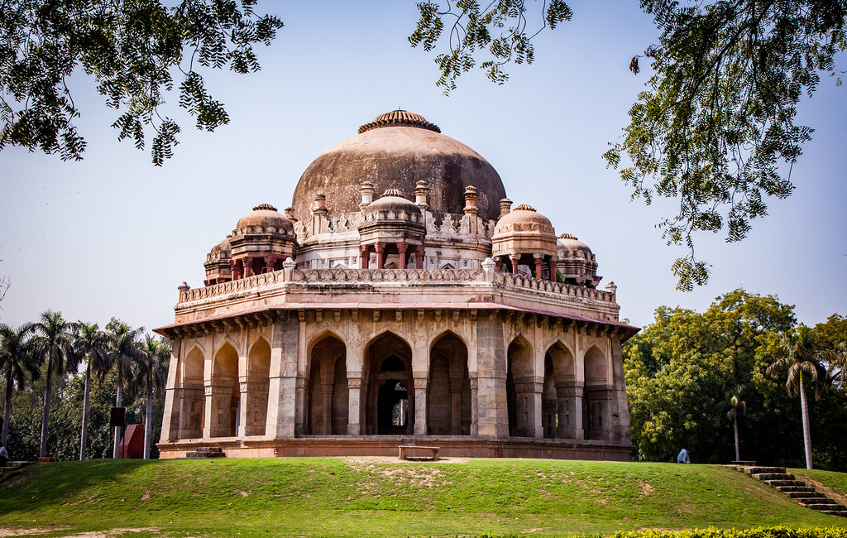
He got translated the Sanskrit book of ‘Ayurveda’ into Arabic language in the name of Farhang-I- Sikandari.
The tomb of Sikandar (by Ibrahim Lodi, in Lodhi Garden, Delhi) is the first example with a double dome.
Also built ‘ Moth ki Masjid’ and repaired Qutub Minar.

Slide 41
Ibrahim Lodhi (1517-1526)
Was defeated and killed by Babur in the first Battle of Panipath in 1526.
Ibrahim Lodhi was the only king in Delhi Sultanate who was killed in a Battlefiled.
With this the Delhi Sultanate ended and Mughal Empire started in India.

